Slide 1
LF Energy
Digital Substation - Design Team #2
(virtualization)
SEAPATH project
Roadmap
September, 2020

Slide 2
Context and motivations

Slide 3

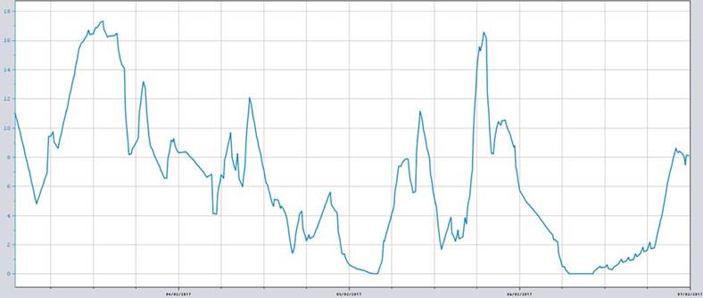
Context
Energy Transition drives change in power transmission and distribution grids. Grid control architecture should adapt swiftly to manage infeed at lower grid voltage levels and greater dynamics in current flow patterns. They should operate more distributed controls in the grids together with a wide range of flexibility services from third-parties.
In this context, TSOs and DSOs require a new generation of Digital Substation Automation Systems (DSAS) that allow more dynamic protection settings and adaptative automation functions. Moreover data management becomes a significant function in itself, both for administration of deployed automation and protection functions, as well as operational grid data.
© 2019-2020 Advantech, Alliander, GE, National Grid, RTE, Schneider Electric, Siemens, licensed under Creative Commons Attribution 4.0 International (CC BY 4.0)

Slide 4
Stakes and mainstays of the next DSAS generation
Innovation
Time & cost-efficiency
Integrate new
Functions and technologies
Keep pace with the changes of grid uses at reasonable cost
Mainstays
Modular & interoperable architecture (IEC61850)
Virtualization
Scalability & Flexibility
Open Source
Cross-industry collaboration
Achieve An “industrial tailor-made” solution
vendor-agnostic implementation and convergence of utility practices
© 2019-2020 Advantech, Alliander, GE, National Grid, RTE, Schneider Electric, Siemens, licensed under Creative Commons Attribution 4.0 International (CC BY 4.0)

Slide 5
Motivations
Stake category | Benefits of open source and virtualization approaches
Time and cost-efficiency | Shared development and maintenance effort through collaboration, avoiding in particular that identical (non-differentiating) functionality is developed and maintained by multiple suppliers duplicating effort.
Time and cost-efficiency | Better reuse of functions enabled by improved modularity and interoperability (e.g. reuse of functions across voltage levels).
Time and cost-efficiency | Remote deployment, supervision, update and upgrade of automation functions and swift switch over between old and new functions, reducing maintenance effort and duration of downgraded service.
Time and cost-efficiency | Automated testing of virtualized functions and systems on digital twin platforms.
Time and cost-efficiency | Pooling of hardware infrastructure and better use of its capabilities.
Cross-industry collaboration | Knowledge sharing and pooling for non-differentiating parts, in compliance with antitrust and procurement regulations.
Cross-industry collaboration | Vendor-and-end-user-agnostic platform implementation, facilitating specification, standardization and integration. Reduced specific requirements and behaviors.
Cross-industry collaboration | Despite less diversity between implementation, mitigation of bugs based of the principle that “with many eyes, all bugs are shallow”.
© 2019-2020 Advantech, Alliander, GE, National Grid, RTE, Schneider Electric, Siemens, licensed under Creative Commons Attribution 4.0 International (CC BY 4.0)
5

Slide 6
Motivations
Stake category | Benefits of open source and virtualization approaches
Scalability and flexibility | Simplified central management of a more diverse set of automation system configurations (different applications and settings across substations).
Scalability and flexibility | Split of hardware and software lifecycles facilitating upgradability (replacement of some parts/functions while keeping others, standardization of hardware while diversification of software).
Scalability and flexibility | Enhanced possibility to remotely adapt, disable, enable automation functions according to specific situations (maintenance, failures, etc.).
Scalability and flexibility | Offline simulations e.g. after incidents.
Scalability and flexibility | Simplified LAN design and testing. Modifications of substation automation systems must be tested against the LAN capacity and in the worst case the substation must be tested completely. By aggregating data to virtualization nodes, the impact on LAN transits is reduced and less volatile.
Innovation | Eased deployment of new innovative functions. Better incremental upgradability.
Innovation | Possibility to build digital twins for the simulation of current functions running in the substations in combination with new functions (prototypes, experiments) and of different grid situations.
© 2019-2020 Advantech, Alliander, GE, National Grid, RTE, Schneider Electric, Siemens, licensed under Creative Commons Attribution 4.0 International (CC BY 4.0)
6

Slide 7
High level principles guiding the project

Slide 8
Project purpose
The aim is to develop a “reference design” and “industrial grade” open source real-time platform that can run virtualized automation and protection applications
It shall be based on open source components while automation and protection applications could be open or proprietary.
It shall be preferentially based on existing open source component(s).
It shall support protection and automation functions.
© 2019-2020 Advantech, Alliander, GE, National Grid, RTE, Schneider Electric, Siemens, licensed under Creative Commons Attribution 4.0 International (CC BY 4.0)
Notes:
Definition of “reference design”: https://en.wikipedia.org/wiki/Reference_design

Slide 9
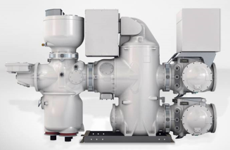
Overview of the new grid control architecture based on virtualization
Implementations based on the “reference” platform from LFE project
IT integration & orchestration center
Supervision & control center
Data Center Level
Data Center Level
Supervision
integration
Key Requirements
Ctrl
Monitoring
deployment
Key Requirements
Digital Twin
Centralized automation
monitoring
Ctrl
test
SCADA
Prot
Prot
Automaton
Automaton
SCADA
Substation Level
Substation Level
monitoring
Ctrl
monitoring
Ctrl
monitoring
Ctrl
monitoring
Ctrl
SCADA
Prot
Prot
Auto
SCADA
Prot
Prot
Auto
SCADA
Prot
Prot
Auto
SCADA
Prot
Prot
Auto
…
© 2019-2020 Advantech, Alliander, GE, National Grid, RTE, Schneider Electric, Siemens, licensed under Creative Commons Attribution 4.0 International (CC BY 4.0)

Slide 10
Project activities
The project will encompass the following activities:
Specifying the requirements to be fulfilled by the reference platform (see next slide)
Specifying the test procedures needed to assess the fulfillment of the requirements
Building the appropriate system(s) architecture(s) for the software platform and specifying requirements for hardware architecture
Developing code for the specific functions and services to be delivered by the platform
Defining and implementing APIs to external applications
Performing the integration of the software platform
Testing the fulfillment of the requirements after the implementation, as a proof-of-concept, of a realistic protection and automation system on top of the integrated software platform [additionally each party may share with the project their internal test results based on proprietary implementations]
Defining guidelines and best practices to test, integrate, deploy, and maintain the applications on such platform
© 2019-2020 Advantech, Alliander, GE, National Grid, RTE, Schneider Electric, Siemens, licensed under Creative Commons Attribution 4.0 International (CC BY 4.0)

Slide 11
Functional requirements (for a first minimum viable product)

Slide 12
Examples of substation systems to be considered for a minimum viable product
Example #1 (from RTE) - Typical 63kV substation
The typical substation includes feeders for up to 5 lines. The layout is one breaker per feeder. Disconnectors between feeders may be included. Each feeder implements the following functions :
Distance protection A
Distance protection B (different algorithm) or Line Differential B
Recloser
Breaker failure protection
Overloading protection
For each feeder, 2 (redundant) sampled value streams (electrical parameter measurements) up to 10 Mbit/s are collected
The following functions are implemented at the substation level :
Gateway to external central or local systems (IEC 61850, 104, etc.)
Local control (HMI, recordings …)
IEC 61131 automation
Phasor Measurement Unit
Misc. (fault location algorithm, slow area automation)
© 2019-2020 Advantech, Alliander, GE, National Grid, RTE, Schneider Electric, Siemens, licensed under Creative Commons Attribution 4.0 International (CC BY 4.0)
Notes:
In Europe, 63 kV substations (or equivalent High Voltage) may be operated by the transmission or distribution operators, depending on national regulations. Thousands of substations of this kind are in use in Europe (approx. 1200 in France). The need for virtualization at this level is driven by the development of renewable energy at distribution level.
Although simplified, the performance requirements of protective functions at HV substations remain similar to those of EHV substations.
Being less critical than EHV substations in case of failures, innovation is easier at HV substations.

Slide 13
Examples of substation systems to be considered for a minimum viable product
Example #2 (from National Grid) – Typical 400kV substation
Typical substation may have 4+ feeders and 4 transformers
Feeder bay functions:
Unit Protection
Distance protection or second unit protection
Delayed Auto Reclose (DAR)
Breaker failure protection
Backup protection (O/C, E/F, Dist)
Feeder end / stub protection
Phase unbalance alarm
BCU, CBU, synch and volt selection
TX bay
CB fail
Pole discrepancy / Phases not together
Phase unbalance alarm
connections prot (unit)
TX O/A prot
REF (restricted earth fault)
backup O/C
Interface for mechanical prot (gas, oil surge, winding temp etc.)
Trip cct supervision
Ferro resonance
Other functions :​
Gateway to external central or local systems (IEC 61850, 104, 101)​
HMI, data recording and logging, health and diagnostic alarms
Phasor Measurement Unit​
Misc. (fault location, QoS, DSM)​
ATCC (Automatic Tap Change Control)
ARS (Automatic Reactive Switching where applicable)
Busbar Protection
Interlocking
© 2019-2020 Advantech, Alliander, GE, National Grid, RTE, Schneider Electric, Siemens, licensed under Creative Commons Attribution 4.0 International (CC BY 4.0)

Slide 14
Examples of substation systems to be considered for a minimum viable product
Example #3 (from Liander) - This is a typical substation for Liander (exceptions are possible).
Substation characteristics
Substation size:
Station voltage level up to 40 bays; usually around 15 to 25 bays of 10/20 kV
Some stations contain 50 kv bays
Voltage levels: 10kV, 20kV and 50 kV
2 to 3 transformers
Per typical bay
Current measurement (Current measurement frequency: 1500 Hz)
2x overcurrent protection
Voltage measurement
Current measurement
Functions below varies per substation
Protection:
Transformer protection: Buchholz
Distance Protection
Line differential protection
Busbar protection
Frequency protection
Earth fault protection
Transformer differential protection
Direction controlled overcurrent protection
General Functions:
Voltage regulator
Interlocking
Synchrocheck
PQ measurement (not MVP)
Voltage measurement
Frequency measurement
Partial discharge measurement (not MVP)
Pressure measurements (Air/SF6)
Transformer oil temperature measurement
PMU
© 2019-2020 Advantech, Alliander, GE, National Grid, RTE, Schneider Electric, Siemens, licensed under Creative Commons Attribution 4.0 International (CC BY 4.0)

Slide 15
Requirement list
The project will specify the requirements to be fulfilled by the reference platform including:
Application isolation
Performance & accuracy
Availability / Redundancy
Scalability
Time synchronization
Data exchange
Supervision
Application deployment and orchestration
Configuration services
Cybersecurity services
Long Term Support and Lifecycle management
Coexistence with conventional devices (failover or hybrid deployment)
© 2019-2020 Advantech, Alliander, GE, National Grid, RTE, Schneider Electric, Siemens, licensed under Creative Commons Attribution 4.0 International (CC BY 4.0)
15

Slide 16
Functional Requirements References for the first MVP
Virtualized platform shall meet the following functional requirements for the first MVP.
Performance requirements
Message transfer time performance shall meet IEC 61850-5 clause-11.2 to the corresponding application class
Protection-11.2.1 & 11.2.4; Automation – 11.2.2; Operator-11.2.3; commands-11.2.6
Time synch performance shall meet IEC 61850-5 clause-11.1.3.3 to the corresponding application class
Data integrity with allowed residual error probability shall meet IEC 61850-5 clause-11.3.2 to the corresponding application class
Reliability to the corresponding application class
Security for protection scheme (e.g. unwanted trips of protection) shall meet clause-11.3.3.2
Dependability for protection scheme (e.g. missing trips of protection) shall meet clause-11.3.3.3
Availability shall meet IEC 61850-5 clause-11.3.4
Communication system: failures, station/bay level, process level, recovery delay, redundancy shall meet IEC 61850-5 clause-11.4
Data model (semantics, addressing, self-description, admin) shall meet IEC 61850-5 clause-12
NOTE: Above requirements are as per IEC 61850 Ed2.0; clauses number will be updated upon latest release of the standard
© 2019-2020 Advantech, Alliander, GE, National Grid, RTE, Schneider Electric, Siemens, licensed under Creative Commons Attribution 4.0 International (CC BY 4.0)
Notes:
Minutes on DT2 meeting on 2020-02- 28: one amendment: it is agreed that the project will not assess the requirements on EMC, construction, environmental base on the assumption that the software will be compatible with hardware fulfilling these requirements (and considering also that the hardware infrastructure for visualization may be subject to less stringent requirements).

Slide 17
System architecture and technology stack (for a first minimum viable product)

Slide 18
Virtualization architecture
Hardware virtualization + OS-level virtualization
RT applications ; jitter < 1ms
Prot. Device 1
Prot. Device n
App 1
App m
RT network ; jitter < 100µs
Container technology
Network management
Container technology
Prot. Device 1
Prot. Device n
Network drivers + devices
Applications with no RT requirements
Software (SW)
App 1
App m
App Services
OS
RT OS
Virtual machines that can host applications (RT or not RT)
RT OS
RT OS
OS
OS
Type-1 Hypervisor + Linux (real-time) + container daemon
Hardware (HW)
CPU
DRAM
CPU
DRAM
NIC
Storage
CPU
DRAM
© 2019-2020 Advantech, Alliander, GE, National Grid, RTE, Schneider Electric, Siemens, licensed under Creative Commons Attribution 4.0 International (CC BY 4.0)
Notes:
An application can be hosted in a :
virtual machine (guest). This guest runs on top of the hypervisor. They are 2 options to reduce the overhead:
Passthrough :the guest interact directly with the hardware. Cons : the guest is not hardware independent anymore
Paravirtualization : hypervisor exposes a modified version of the physical hardware interface to the guest. Cons : the guest needs to be compatible
container. A container can be run directly on the host or in a guest:
Pros: small overhead , small size
Cons: use the kernel of the host (not possible to run windows container directly on a Linux host and vice versa) , less isolation
The network can be handled by :
the host drivers. However the 100µs jitter for sample value (61850 9-2) is difficult to achieve with this configuration.
DPDK and a virtual switch (OVS-DPDK) : CPUs and memory and NIC are dedicated to OVS-DPDK. In this configuration 100µs jitter for sample value is a realistic target.

Slide 19












Technical architecture and stack
Data center services
Platform services
Non-platform / Third party services
Deployment
Monitoring
Platform monitoring
Orchestration
Cybersecurity
Cybersecurity
Fault detection & recovery
Protection App
Automation App
OT monitoring
App
Network administration
Redundancy (cluster)
synchronization (ptp)
Gateway
…
…
VM administration
Container administration
Low latency 61850 stack (100µs)
Firmware
Hardware
Best effort CPUs
Real time CPUs
General purpose memory
Real time purpose memory
Process NIC
Administration NIC
© 2019-2020 Advantech, Alliander, GE, National Grid, RTE, Schneider Electric, Siemens, licensed under Creative Commons Attribution 4.0 International (CC BY 4.0)

Slide 20
Technology options
Hardware/chip architecture options:
x86 is retained as the reference chip architecture for the MVP
The project should nevertheless consider that the platform should support ARM architecture in a second stage
Hypervisor options:
Linux / PREEMPT_RT is retained as the reference kernel for the MVP
Other options are discarded for the time being: Xenomai seems to have little industrial support, ACRN is not mature enough to date though promising (thus it should be kept in the radar for a later stage)
Linux distribution:
Yocto provides a reference set of tools to build Linux distributions for embedded critical systems
Two options are identified for the core distribution of the project: building a specific distribution using Yocto tools or reusing the core distribution from CIP (https://www.cip-project.org/) which relies on Yocto ➔ The decision is to start with Yocto for prototyping the MVP and to engage a discussion with CIP in parallel in order to assess the possibility of reusing CIP.
Platform and application orchestration:
Kubernetes is considered as the reference choice for container orchestration
© 2019-2020 Advantech, Alliander, GE, National Grid, RTE, Schneider Electric, Siemens, licensed under Creative Commons Attribution 4.0 International (CC BY 4.0)
Notes:
Pros for reusing CIP: leveraging the long term maintenance effort from CIP (10 years support)
Cons for reusing CIP: old Kernel version and possibly missing support on needed firmware of software component
Need to engage with CIP once requirements are cleared in order to assess pros and cons

Slide 21
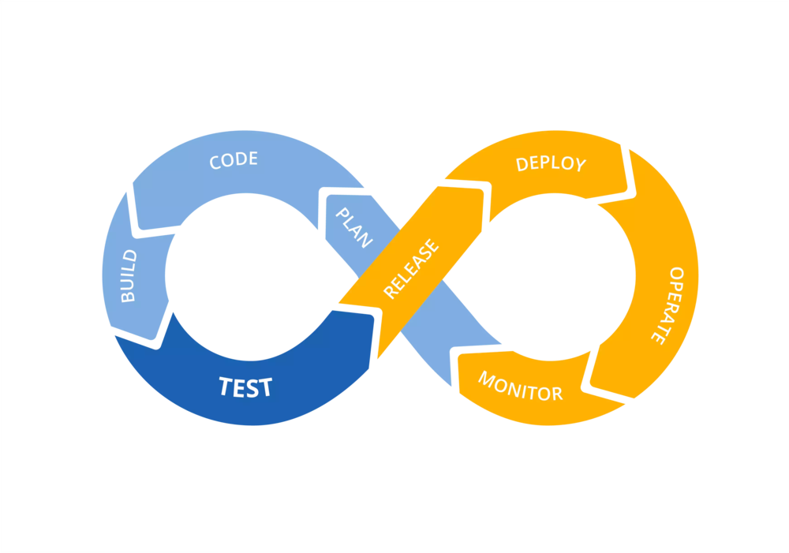



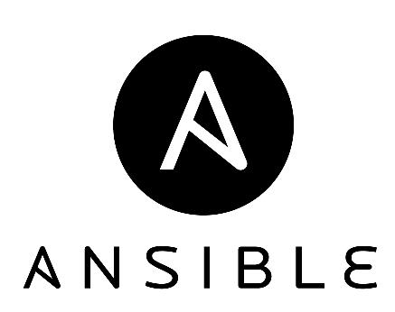

Configuration and test
Configuration tools needed to:
set up the platform
build the firmware
integrate real time and best effort applications (VM or container)
Testing tools to :
assess the performance of the platform
achieve function tests
Automatic tests based on common scenarii
Development of new scenarii and automation of commissioning and maintenance routines
© 2019-2020 Advantech, Alliander, GE, National Grid, RTE, Schneider Electric, Siemens, licensed under Creative Commons Attribution 4.0 International (CC BY 4.0)

Slide 22
Priorities and contributions (to reach the minimum viable product)

Slide 23
Priorities at the launch of the project for the development of a Minimum Viable Product
Project activity / topic | Priority rank | Comment
Specifying the requirements to be fulfilled by the reference platform | 1st priority | 0.7 FTEs of expert and architect contribution
Specifying the test procedures needed to assess the fulfillment of the requirements | 1st priority
Building the appropriate system(s) architecture(s) for the software platform and specifying requirements for hardware architecture | 1st priority
Developing code for the specific functions and services to be delivered by the platform | 2nd priority
Defining and implementing APIs to external applications | 2nd priority
Performing the integration of the software platform | 1st priority | Contribution of a preliminary integrated platform (packaged Linux distribution and associated building scripts, including also generic performance testing tools) 2 FTEs contributing to the integration and testing of the platform.
Testing the fulfillment of the requirements for automation applications after the implementation, as a proof-of-concept, of a realistic automation system on top of the integrated software platform | 1st priority (*)
Testing the fulfillment of the requirements for protection applications after the implementation, as a proof-of-concept, of a realistic protection and automation system on top of the integrated software platform | 2nd priority
Defining guidelines and best practices to test, integrate, deploy, and maintain the applications on such platform | 2nd priority
© 2019-2020 Advantech, Alliander, GE, National Grid, RTE, Schneider Electric, Siemens, licensed under Creative Commons Attribution 4.0 International (CC BY 4.0)
Notes:
(*) Although the MVP targets both automation and protection applications, with a realistic ambition to reach a qualified industrial-grade implementation by end of 2023, the project should strive to qualify an intermediate version of the platform for automation applications by end of 2021.

